Slide 1
Aimee Gedge
Supporting Excellence Officer
Supporting you to work with young people
www.momentumnorfolk.org.uk | 01603 672333

Slide 2
Momentum Youth Award for Volunteering
Originally developed by Norfolk County Council (when it was called the Norfolk Youth Award), taken over by Momentum due to Youth Service changes
For young people aged 11-25
Designed for use in youth clubs but can be adapted to lots of different settings
Free of charge – for members and non-members
Pathways to other award schemes such as vInspired and Youth Achievement Awards (UK Youth)
Young people who complete the award are eligible for the Momentum Volunteer Award category of the Norfolk Youth Awards, an awards ceremony organised by OPEN Youth Trust. The winner of the Momentum Volunteer Award will also be put forward for the EDP’s Stars of Norfolk and Waveney award.

Slide 3
Three sections:
Personal Development
Working with Others
Making a Difference to your Community
Five hours minimum commitment per section
No time limit – young person works at their own pace
Young people set their own goals and decide how they are going to achieve them
Sections can be done in any order
No requirement to do all three sections

Slide 4
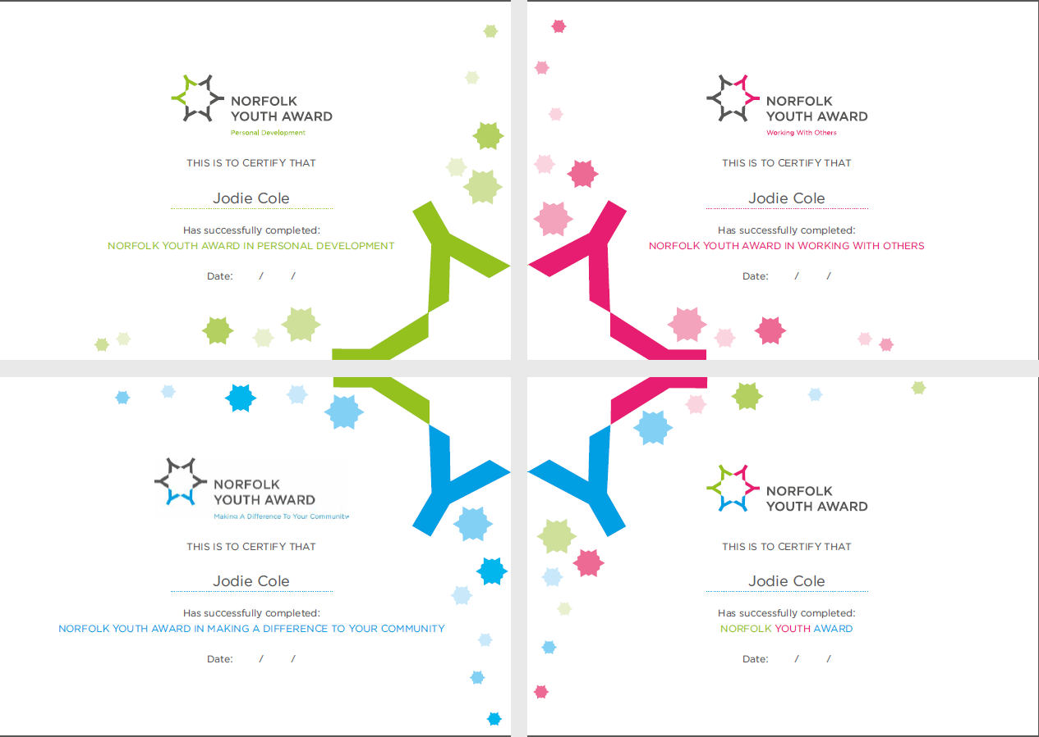

Slide 5
Personal Development
Developing a personal quality, learning a new skill or discovering a new interest
Examples:
Improving confidence and social skills
Taking part in formal or informal training (e.g. a first aid course or a skills workshop)
Trying something / going somewhere new for the first time
Giving a talk or presentation to other young people
“My personal goal is to improve my whittling skills and knowledge of plants and trees.
I will attend Woodland Warriors where leaders can show me new techniques and teach me about plants and trees.”
(Young person from Nurture by Nature Forest School)

Slide 6
Working with Others
Working well as a team, bringing good qualities to a group
Examples:
Joining a youth committee or project working group
Gaining confidence in group settings, contributing more in group discussions
Going on a residential with other young people they don’t know
Working with a team to organise an event or trip
“My personal goal is to improve my communication skills when talking to the group.
I will bring up more of my ideas and learn to be less shy.”
(Young volunteer from Nelson’s Journey)

Slide 7
Making a Difference to Your Community
Having a positive impact on the local community
Examples:
Taking part in a conservation project or tidying up a local park
Volunteering to teach computer skills to older people
Acting as a peer mentor or befriender
Helping to organise a charity fundraising event
“My personal goal is to help other young people being bullied and try to guide them and help them to solve their problems. I am going to learn about what to do if someone is being bullied and where to signpost them to.”
(Young person from Carers Trust Norfolk)

Slide 8
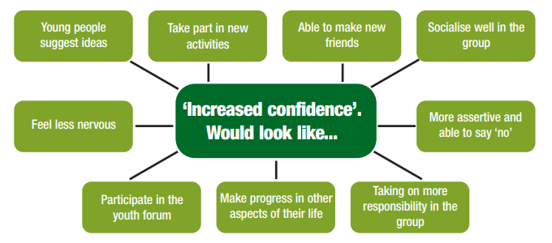
Setting goals
Goals should be SMART: specific, measurable, achievable, realistic, time-bound
They should be written in first person: ‘I will’, ‘my goal is’
Encourage the young person to really think about what they want to achieve in specific terms – ask them ‘what would achieving your goal look like?’
Taken from Youth Work Essentials guide to measuring outcomes:
http://www.youthworkessentials.org/media/51546/measuring_outcomes_lres.pdf

Slide 9
It doesn’t have to involve three separate projects
Billie and Max are young volunteers at their youth club. Every week they arrive half an hour early to help set up the room and welcome other young people, especially those who are new to the club. During the two hour session, they help run activities. Max usually helps on the craft table, and Billie loves coming up with new ideas for active games which she teaches to the other young people.
After the club has finished, they stay behind for half an hour to pack up. Max helps one of the adult leaders to count the subs money and the tuck shop money, and completes a balance sheet.
They do this every week for a whole term and exceed the minimum 15 hours for the Norfolk Youth Award (12 weeks x 3 hours = 36 hours).
At the end of term, they have a meeting with the adult volunteers to talk about how the term went and what they could improve for next term.

Slide 10
Personal Development:
Billie’s goal is to improve her leadership skills by leading games and activities.
Max’s goal is to learn how to complete a balance sheet for the tuck shop and subs money.
Making a Difference to your Community:
Billie’s goal is to improve the club by including more varied activities and games.
Max’s goal is to befriend young people who are new to the club and
show them around, so that they feel welcome and know where everything is.
Working with Others:
Max and Billie have the same goal of working with each other and with the adult volunteers to make the club run smoothly and make it an even better place for local young people.

Slide 11
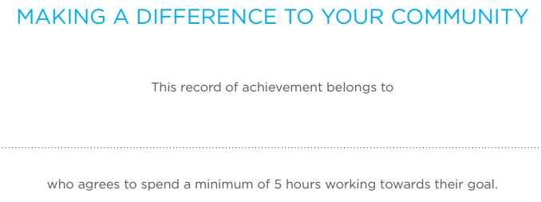
Sam Wilson
11 04 18
23 07 18
8

Slide 12
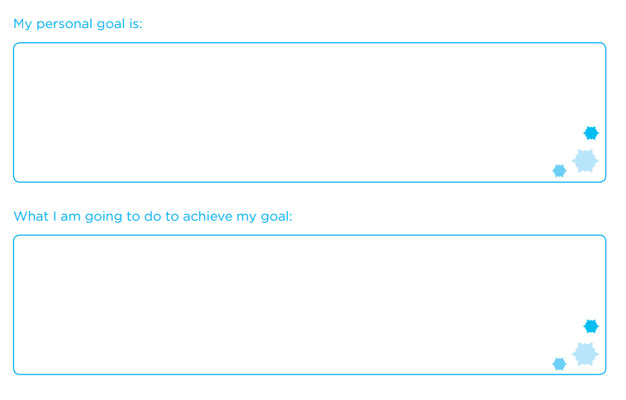
To make the park a nicer place for people in my community to spend their time
I am going to help organise and take part in a community litter pick with people from my youth club

Slide 13
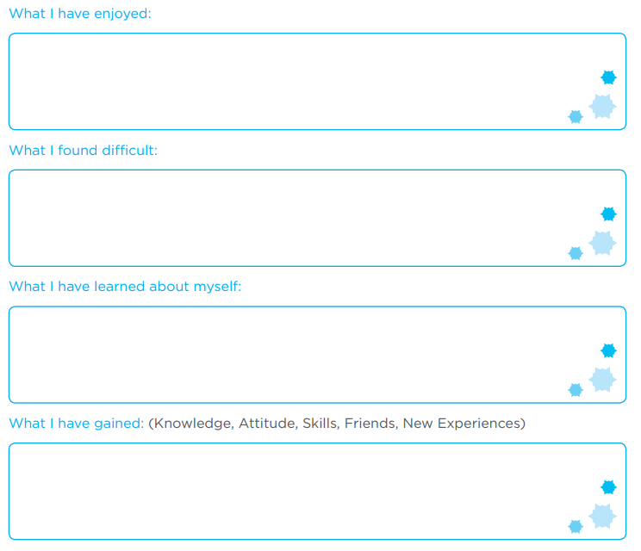
Feeling proud once the litter pick was finished and the park looked loads better
Working together with my friends from youth club
Picking up litter was hard work and some of it was really disgusting and smelly
I am good at organising things and I can be a good leader, giving out tasks and explaining to people what they need to do to get the job done
Skills in organising community events Getting to know older people in the community who came to say hello when we were litter picking

Slide 14
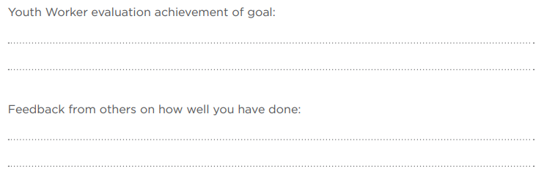
Sam showed great leadership skills and learnt to delegate tasks instead of trying to do it all by himself. He worked hard at the litter pick event and made a real difference, and he kept everyone’s spirits up when they were flagging.
Youth Worker evaluation should:
Be written by someone who has supervised the young person
Be written at the end of the project
Be specific to the young person – don’t write the same thing for everyone
Be honest but supportive
Help the assessor get an idea of the young person’s ‘distance travelled’
Refer to the young person’s goal
Act as an endorsement that the young person has done enough to achieve their goal, based on your judgement

Slide 15
Sam kept everyone focussed and on task and as a result the litter pick was a real success.
He picked up loads of litter and made the park look a lot better.
Sam kept cheering us up by making jokes when the litter pick was getting really hard! His jokes made it a lot more fun and we finished the whole park.
Feedback from others should:
Be written by people who has witnessed the young person’s achievements
Be supportive and positive
Be specific to the young person
It can be written by other young people or other staff/volunteers. They can either contribute to the form directly or the lead youth worker can collect comments from the whole group on a separate sheet of paper which can be sent in alongside the forms.

Slide 16
What people say…
“The Momentum Youth Award for Volunteering worked really well for the young people who took part in our anti-bullying project and was really simple to understand and administer.
I really liked the fact that the young people could choose which of the areas they wanted to focus on – another real strength of the award is that it allows the young people to really reflect on what they have got out of the project. I would definitely recommend to anyone working with young people on projects.”
Lead Participation Worker, Carers Trust Norfolk
“From my perspective, the Momentum Youth Award for Volunteering gives us an opportunity to have quality time with each young volunteer to ask their goals and expectations on what they want to achieve from working with us.
It is presented in a clear, simple and effective way which makes it easy to do. It allows us to identify ways to support and encourage the young volunteer as they progress. We also use it as stepping stone into our own awards scheme to recognize the achievements of young people within our organisation.”
Senior Bereavement Support Worker, Nelson’s Journey

