Slide 1
Monitoring & Evaluating Outcomes Stuart Riddington and Cindee Crehan
Notes:
Stuart
What is your destination? (GPS), each grant will want different monitoring, your organisation will want monitoring to improve, sport’s teams monitor athletes, engineers monitor equipment, mechanics monitor vehicles (MOT), teachers monitor pupils progress, trustees monitor charities.

Slide 2
Aims & Outcomes
What are the Course Aims?
This course will enhance the monitoring and evidencing for your organisation, creating stronger structures and systems for reporting back to funders through your grant reports and growing your organisations best practise
What are the Learning Outcomes
Improve the operation and management of your reporting to funders
Make use of logical, strategic and result-orientated frameworks to control and monitor programmes and projects
Collect and manage data to inform learning and identify solutions and present the results of the evaluation analysis
Plan and track the benefits of projects
Notes:
Stuart

Slide 3
What does monitoring mean to you?
Notes:
Stuart

Slide 4
What does monitoring mean to you?
‘Observe and check the progress or quality of (something) over a period of time.’
‘Keep under systematic review’
Notes:
Stuart

Slide 5
Game Time: Chinese Whispers
Notes:
Stuart
2 volunteers to do their elevator pitch

Slide 6
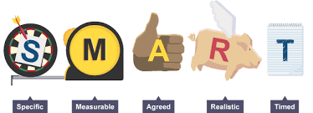
Stage 1 – Understand what you need to monitor and evidence
What do you currently do or use?
What do funders (and prospective funders) want to know?
What do Trustees and the Senior Management Team want to know
Map out projects with your new system
S.M.A.R.T
Notes:
Cindee
Question: Ask the group what they currently do and how they monitor it / evidence their outcomes?
The key to successful monitoring is planning and thinking about the systems that you already have in place for monitoring. What do I need to have shown by the end of the year – do I have the systems in place to gather this data?
Think about what you already do (and measure) that funders would want to know. What have you said that you will do?
Qualitative and quantitative data – you need a mix, quantitative is easier to gather, but harder to show impacts.
Your reporting to trustees and senior management team should be used for your reporting to funders – don’t do the same job twice.
Set up your systems to monitor your data. Have you got baseline measures so that you can show increase / improvement / progression? If not, use the first month of the project to gather them. Remember too that your monitoring has to be acceptable to your service users – consult!
Outcomes need to be Specific, measurable, achievable, realistic and timed. You can also be creative in the way you monitor and show outcomes.

Slide 7
What do Funders want?
Notes:
Cindee
Very easy to put in funding applications what impact you will show, but then at the end of the year struggle to prove it. Good planning starts with writing the application – this is the point at which you should be thinking about your baseline measures and what you need to put in place to monitor and evidence your outcomes.
How am I going to evidence the outcomes that I have said I will achieve?
Are the financial systems of my organisation set up in a way that will allow me to show the costs and spend on this project? If not, get them set up.

Slide 8
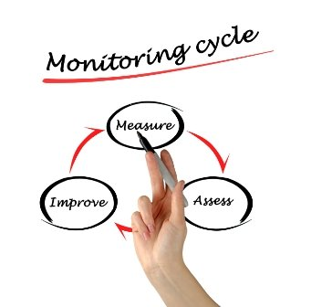
1. Measure How do we collate information? What tools can we use? 2. Assess How do we review information How do we compare information? Are we heading in the right direction? 3. Improve Best practise How doe we evolve our work? Continual change management
Stage 2 - Monitor programmes and projects
Notes:
Stuart
Wave Effect
Write down what you think each position means?

Slide 9
Stage 3 - Collect and manage data
The key to data is to remember it is not numbers or words; it is people.
You have to know what you have
You have to know what you need
It has to be in good shape
Ability to cross reference or link data
Find the software that works well for you charity: productivity apps, contribution management, accounting software, CMR (customer relationship management) etc
Notes:
Stuart

Slide 10
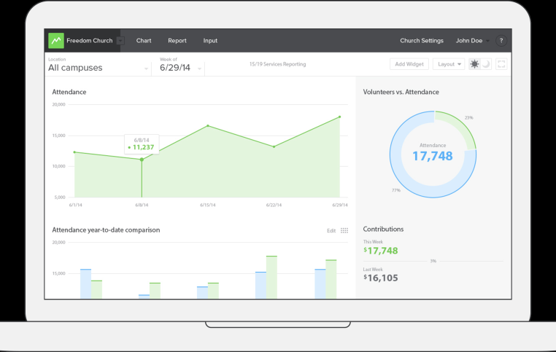
Stage 3 - Collect and manage data
App Game
Database systems: CharityLog, Blackbaud, Sales Force, ThankQ, Excel, Access
Old School – Forms, feedback and case studies
Notes:
Stuart
Illustration: Who has a monitoring app on their phone? (me: Find iPhone, RunKeeper, Freeletics, Metics, e-mails, social media, etc)

Slide 11
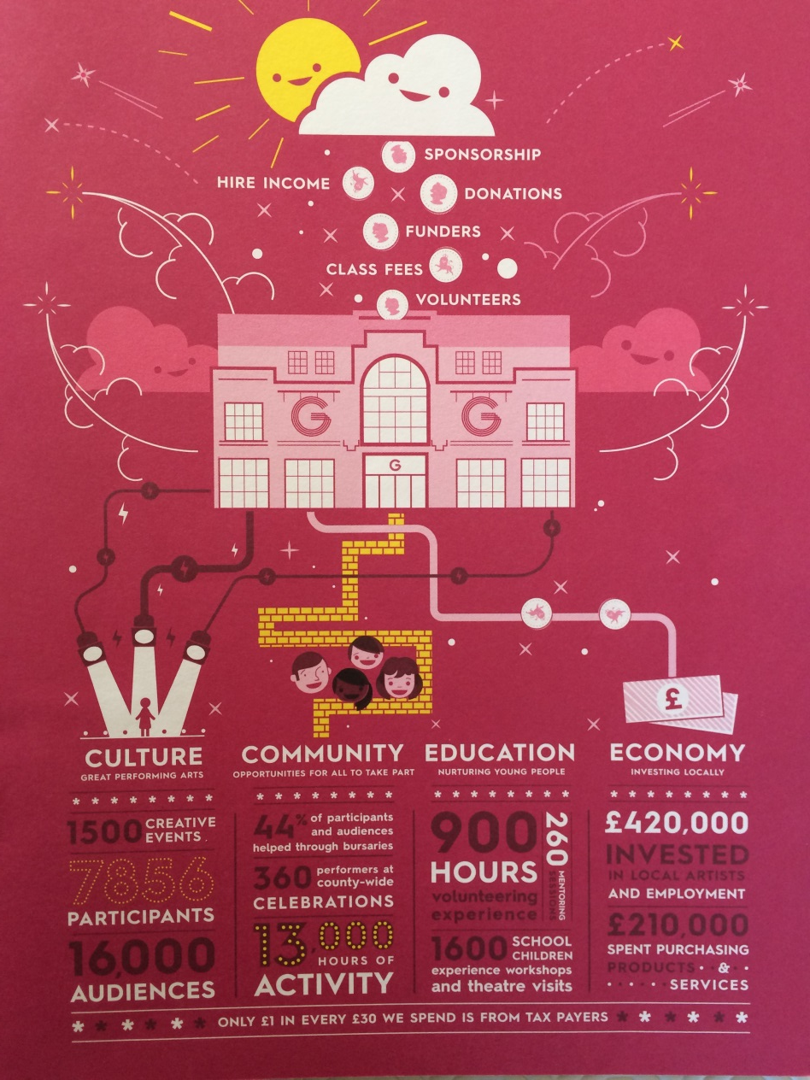
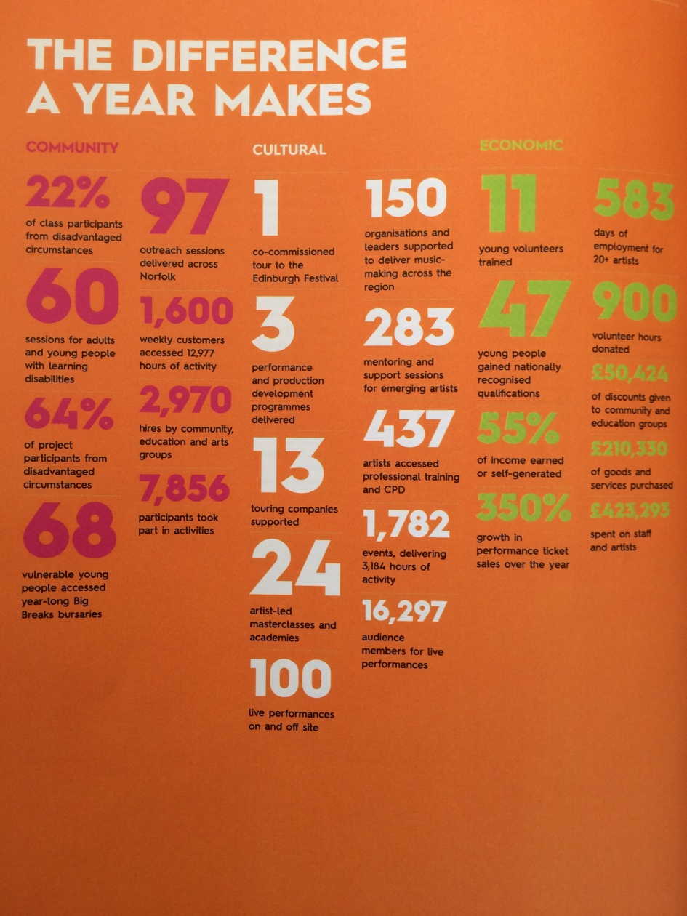
Stage 4 – Produce your reports
Notes:
Cindee
Be creative in your reporting back. Find an exciting way to show the headlines and / or quantitative data.
By using your reports for boards to build up your overall reporting you get opportunity to adjust and improve the data you collect on the way.
Case studies – collect at least monthly – don’t wait to the end of the year – service user might have gone! Allows you to get their feedback too.
Keep your reporting clear, concise and consistent – no-one wants to read rambling pages – put it on a plate. Make sure it adds up!
Go for the feel good factor. Funders want to feel that their money is making a difference. Momentum small grants.

Slide 12
Stage 4 – Produce your reports
Notes:
Cindee
Hopefully when you get to this point – it will be easy and you will have all the data and evidence that you need – you will just be collating the data you have, rather than trying to find it.

Slide 13
Monitoring & Evaluating Outcomes
Notes:
Stuart

Slide 14
Resources
Local:
www.charityedge.co.uk
National:
www.blackbaud.co.uk
www.salesforce.com/uk
Institute of Fundraising
www.fundraising.co.uk
Where there is vision and life change, funders will fund!
Notes:
Stuart

Slide 15
‘Aim for nothing, and you will hit it every time’ Shawn Sherrick
Notes:
Stuart

