Slide 1
Who we are
The Living Wage Foundation is at the heart of a movement of organisations, businesses and people who believe a fair day’s work deserves a fair day’s pay
Accreditation
Intelligence
Influence

Slide 2
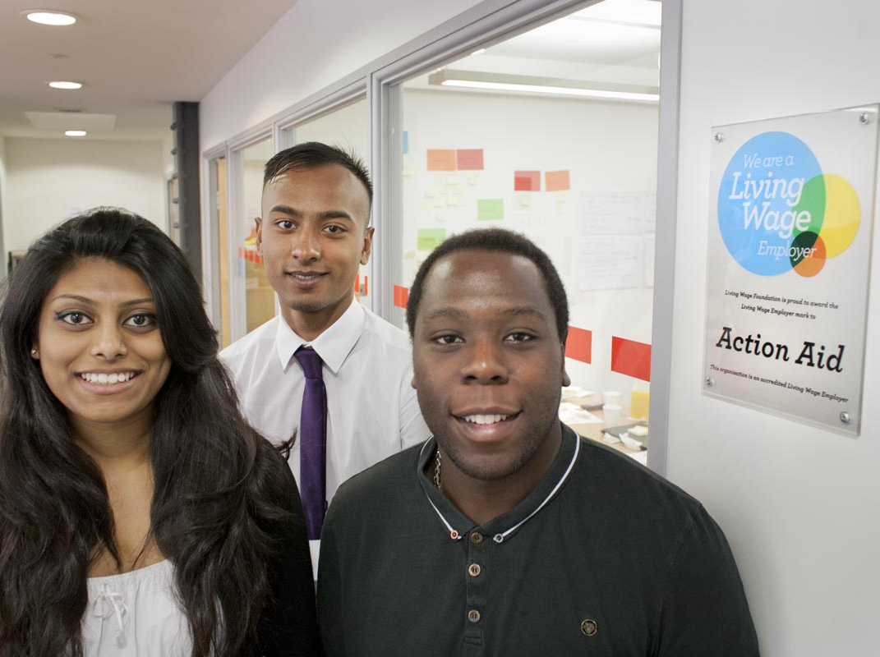
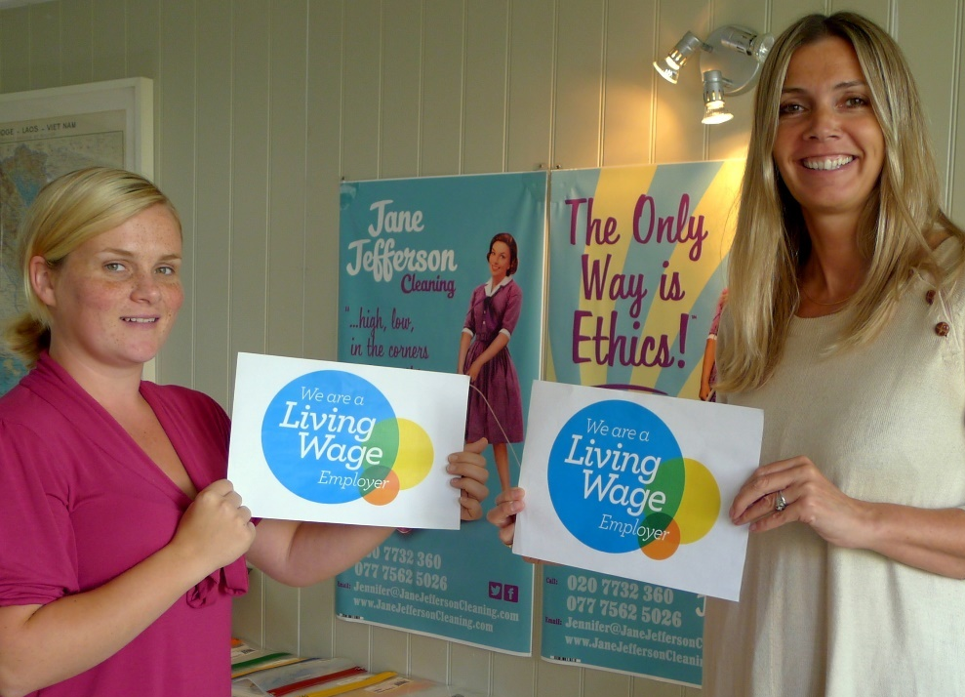

Slide 3
Growth of Living Wage movement

Slide 4
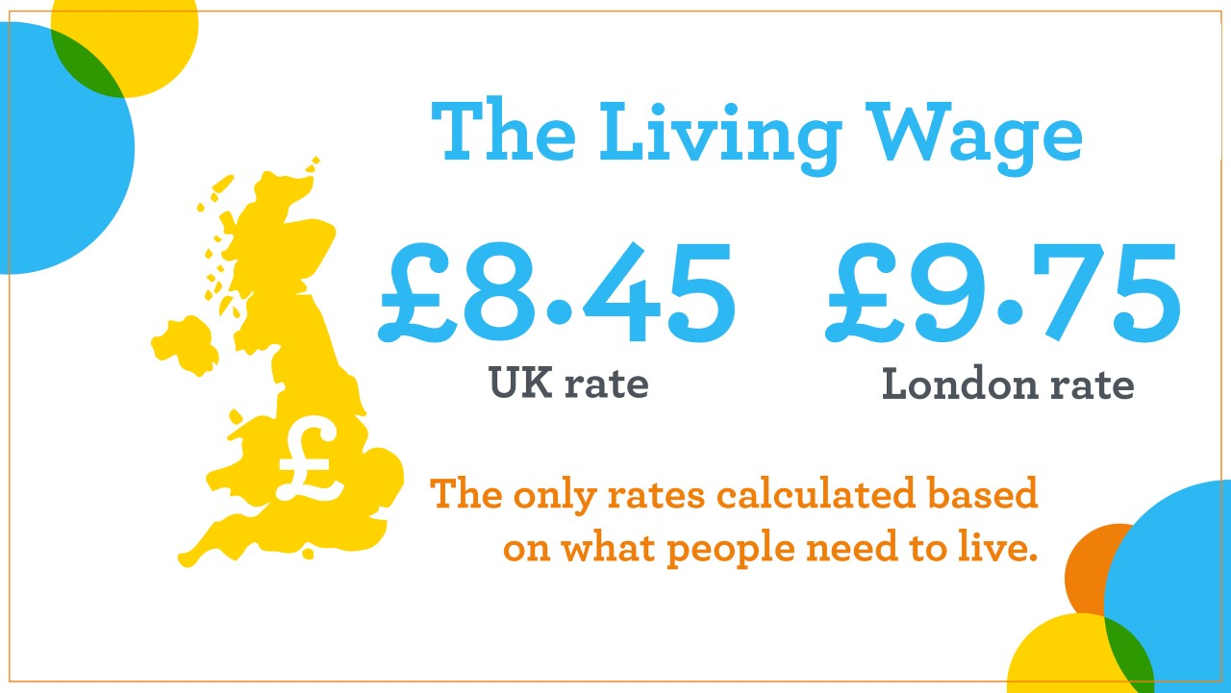
NEW RATES

Slide 5
What’s the difference?

Slide 6
Engaging employers

Slide 7
