Slide 1

Our senior structure and
new operating model
within Children’s Services

Slide 2
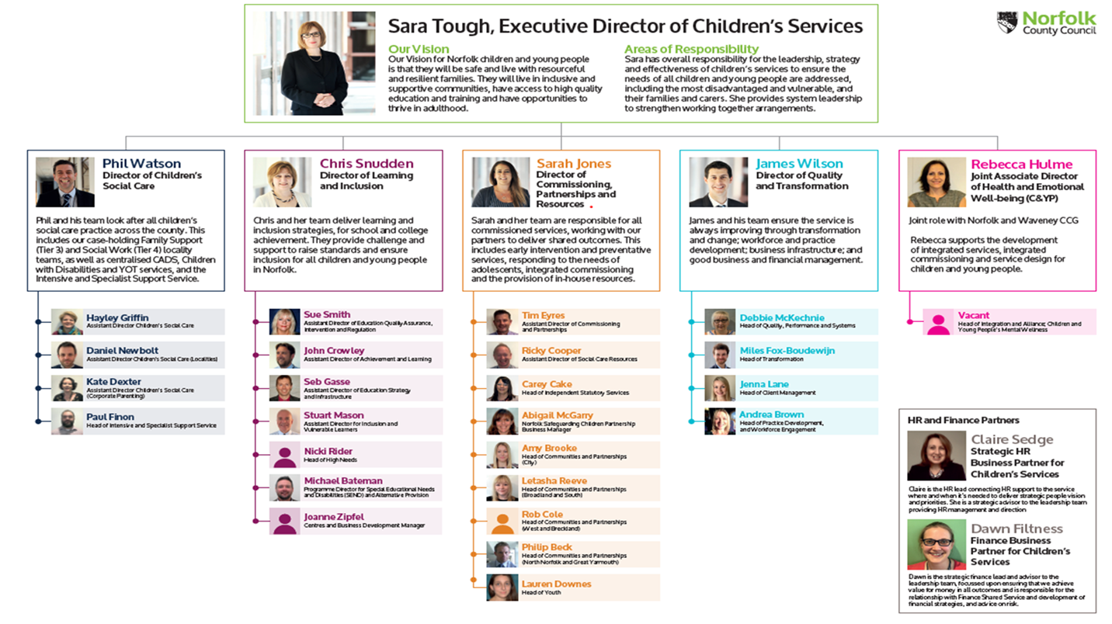

Slide 3
Objectives of the New Operating Model
Develop a clear Norfolk methodology and brand which is applied as a whole service approach
Increase the time teams have to complete direct work with families by unburdening them from administrative responsibilities
Reduce the number of handoffs between teams in the model and further improve the stability of relationships for children
Introduce a greater skill mix so that families benefit from richness in knowledge, skills and experience
Ensure resources are deployed where they can make the biggest impact – particularly the front door, in early help, and in intensive support – to reduce the need for care proceedings
Address the current challenge in recruitment and retention of social workers and over-reliance on agency staff
Increase management and co-ordination support to teams so that every case is gripped and prioritised

Slide 4
Enhanced Front Door – Children’s Advice and Duty Team
Practice Co-ordination provided to prevention, protection & locality intervention support
How does the new model work?
Operational Support
Practice Co-ordination provided to prevention, protection & locality intervention support
Countywide Services
e.g. CWD, Family Networking/FGC, Stronger Families, UASC
Prevention
Case-leading roles e.g. Family Practitioner, Senior Family Practitioner
Protection
Case-leading roles e.g. Social Workers, Senior Social Workers
Called-in when support required
Called-in when support required
Locality Intervention Support
e.g. Domestic Abuse, Home-based Support, Edge of Care, Substance Misuse and Mental Health

Slide 5
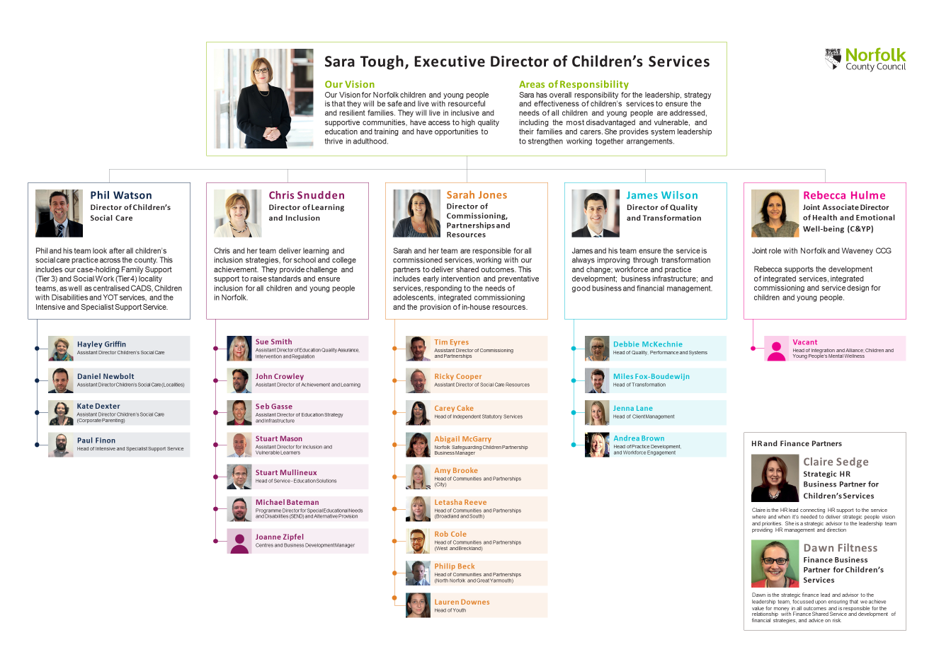
Meet the new Commissioning, Partnerships & Resources Team

Slide 6

Community and
Partnerships Teams

Slide 7
The aims of our Community & Partnerships Teams
Preventing families needing support from children’s social care and intervening earlier.
Helping parents and families be more resilient in communities
Provide system leadership across the early help partnership
Making early help everyone's responsibility.

Slide 8
Who are we…..
Community Focus:
Develop local networks of support to meet gaps in provision and respond to NCC priorities
Provide information, advice and signposting to universal services for CS staff and partners
Analyse local data and trends to inform need and identify gaps
Partner Focus
Support professionals initiating and co-ordinating Family Support meetings
Training and development for professionals
Individual support to professionals who are working with children, young people and their families
Do not work directly with families

Slide 9
Who are we…..
Community & Partner Focus Managers:
Manage a team of Community Focus and Partner Focus Workers across two localities
Be an integral part in the locality hub arrangements, developing effective relationships with partners to enhance whole family working across the partnership
Undertake multi agency audits to understand and respond to gaps and local priorities
Attend safeguarding school cluster meetings providing support and challenge to the approach to early help and prevention
Head of Communities & Partnerships
Lead as countywide specialist for a designated area of policy or service provision.
Gain the commitment of relevant delivery partners and stakeholders to achieve shared objectives and integrated working through system leadership
Ensure a countywide approach to delivering EHP services with consistent standards, while adapting to local variations
Develop and improve services based on evidence that improves children’s experiences of family life, parenting and outcomes for families.

Slide 10


Special Educational Needs Transformation
Aiming to improve strategic leadership, sufficiency and quality of provision to meet special educational needs

Slide 11
In July 2019 the Health & Wellbeing Board endorsed Norfolk’s Area SEND Strategy and its 4 key priorities:
THE SEND JOURNEY Simplifying the ‘pathways’ for families and professionals. Making it easier for children and young people with SEND to have their needs identified and assessed with the right support put in place
SEND PROVISION Co-producing jointly commissioned, integrated, SEND services and provision and ensuring sufficiency of specialist placements
THE LOCAL OFFER Improving confidence in the local offer by ensuring it is communicated effectively and kept under review. The local offer will be responsive to the needs and aspirations of children and young people, their families and professionals who support them
PREPARATION FOR ADULT LIFE Ensuring seamless transitions for young people and their families into further and higher education and employment, including support for housing, health and social inclusion

Slide 12
SEND Transformation:
The transformation programme will operate over a 5-year period (2019 to 2023) and has been reviewed for the 2nd year of implementation across a combination of Transformation Workstreams and Rapid Action Teams:
Transformation Workstream A: SEND & Alternative Provision Support and Inclusion
Transformation Workstream B: Infrastructure and New Provision
Rapid Action Team 1: EHCP performance improvement
Rapid Action Team 2: Virtual School Alternative Provision

Slide 13
SEND and AP Transformation Programme: 2020 Programme Structure
Programme Board
Chris Snudden
Director Learning & Inclusion
James Wilson
Director of Quality & Transformation
Michael Bateman
Programme Director
Steve Gale
Programme Manager
Sue Smith
Assist. Director of Education, QA, Intervention & regulation
Sarah Shirras
Chair Schools' Forum & Educate Norfolk
Kate Hinchley
SEND & AP Transformation Officer
John Crowley
Head of Education Achievement and Early Years Service
Stuart Mason
Head of Ed Vulnerable Groups Achievement and Access
Sebastian Gasse
Head of Ed Participation, Infra and Partnership Service
Nicki Rider
Interim Head of Education High Needs SEND Service
Maxine Blocksidge
Senior Advisor SEND & AP Strategy
Workstream A
Workstream B
Rapid Action Team 1
Rapid Action Team 2
SEND & AP Support and Inclusion
Infrastructure and New Provision
EHCP Performance Improvement
Virtual School AP
To ensure sufficient good quality and affordable SEND provision enables children and young people to be educated in their local mainstream school and to ensure that settings are using best endeavours to provide and secure an inclusive education for all children and young people with SEND, thereby setting out expectations and increasing parental confidence in individual schools’ local offers
To gather requirements from other workstreams, collectively identifying the location and design of new specialist provision, including new special schools, specialist resource bases and other support hubs. This workstream will then build the new specialist provision in a co-ordinated service delivery.
To maintain our person centred approach to EHCP assessments and rapidly increase the proportion carried out within 20 week timescale and ensure that quality, timely, annual reviews are carried out for young people with EHCP's.
To rapidly establish a virtual School for AP, including its business design, structure, resourcing, processes and procedures, communications and rolling out into a BAU establishment.
EHCP & S19 Improvement & Compliance Group
Chaired by Sue Smith
Programme Finance & Performance Benefits Realisation – Michael Bateman
Includes the Placement & Transport Cost Tracker
Communications Strategy – Kristina Fox
Single version of the truth DATA – John Crowley

