Slide 1
Improving health outcomes for children and young people
Dr Louise Smith
Director Public Health
5 June 2018

Slide 2
Norfolk’s Children
About 9,000 births / year in Norfolk
12.6% of school children are from a minority ethnic group
Children and young people under the age of 20 years make up 21.3% of the population of Norfolk.
0 -4 years 47,900
5 – 19 years 140,300
By 2025 7% increase

Slide 3
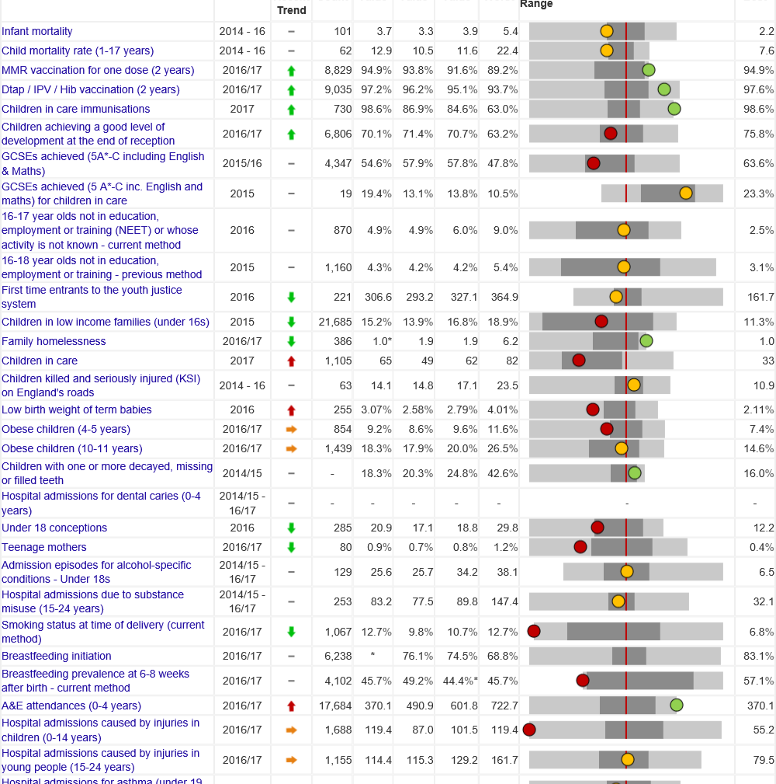
Public Health Outcomes in Norfolk
Public Health England outcomes framework
https://fingertips.phe.org.uk/profile-group/child-health

Slide 4
Health outcomes
with 12.7% of women smoking while pregnant.
The health and wellbeing of children in Norfolk is generally better than the England average but not the East of England average.
Infant and child mortality rates are similar to the England average.
The percentage of women smoking in pregnancy is higher than the England average.
Obesity levels are similar to the England average.
Hospital admissions for injuries are high for <15 year olds.
9.3% of children aged 4-5 years and 18.0% of children aged 10-11 years are classified as obese.
Over 1,6000 children are admitted to hospital with accidental injuries each year

Slide 5
Socio-economic outcomes
The rate of family homelessness is better than the England average.
Child poverty is better than the England average.
GCSE achievement: only 55% of young people gain five or more GCSEs at A* to C grade including maths and English.
Teenage pregnancy rates have fallen to below England average but the average rate hides higher levels in Great Yarmouth & Norwich
18% of children aged <16 years live in poverty
20 girls aged under 18 conceived for every 1,000 women aged 15-17 years in Norfolk

Slide 6
Young People
Outcomes
Admissions for self harm are higher than the England average.
The rate of young people aged <18 admitted to hospital due to alcohol is decreasing and is lower than the England average.
The rate of young people aged under 18 being admitted for of self-harm is increasing. Nationally, levels of self-harm are higher among young women than young men.
First time entrants to youth justice are reducing but are higher than average
325 young people enter the youth justice system each year

Slide 7
2017 Norfolk Children and Young People Health and Wellbeing Survey
56 Educational Establishments
11,088 students
(school years 4–12, age 8-18)
Building on 2015 survey
Content agreed by stakeholder group including representative from Children Services, Constabulary, Education, Third Sector
Format adapted for primary, secondary & Further Education
Completed during two weeks October 2017
Online, in lesson time
Supervised

Slide 8
Survey Topics Included
01
Demographics
06
Access to services
02
Attitudes to school/college
Safeguarding
07
Diet
Healthy Weight
03
Bullying
Relationships
08
Online Habits
Mobile Phone Use
04
Aspirations
09
Emotional Health
05
Drugs
Alcohol
Smoking
10
Police & Crime
Road Safety

Slide 9
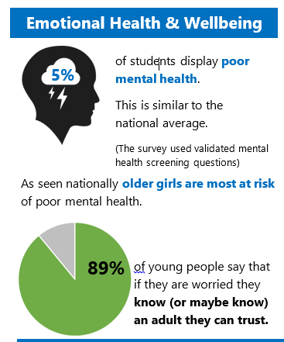
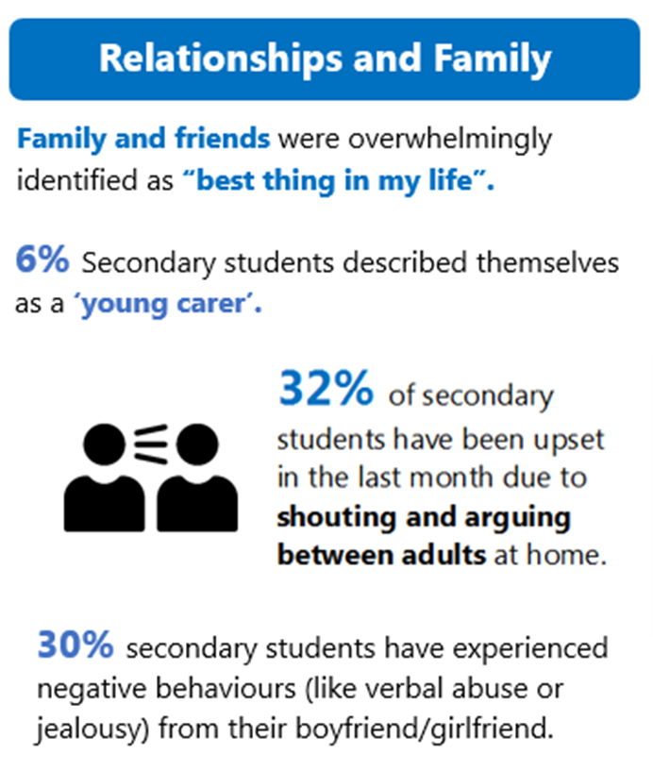

Slide 11
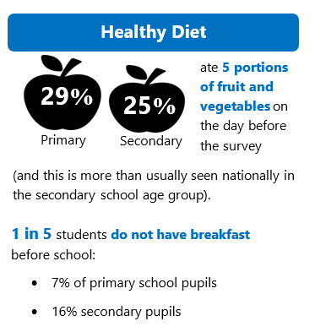
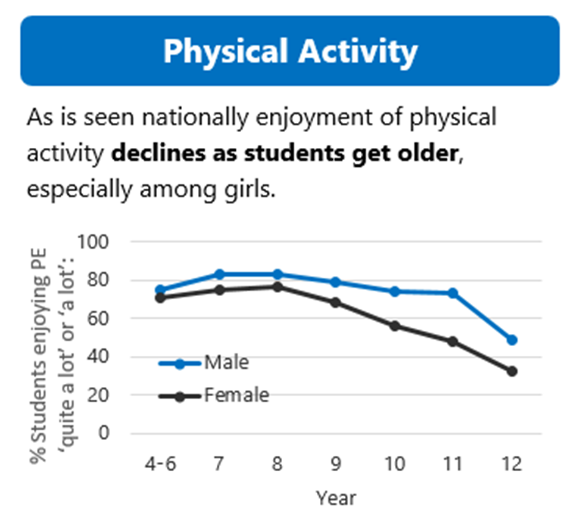

Slide 12
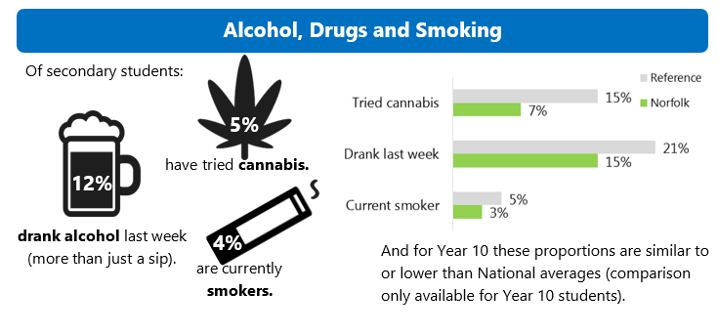

Slide 13
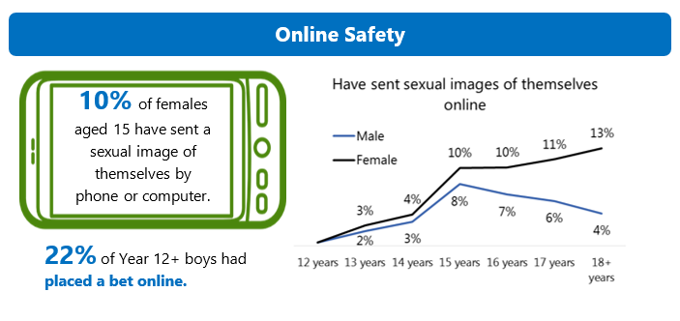
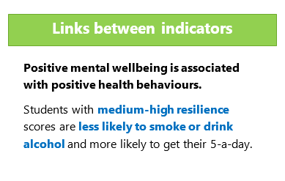

Slide 14
Public Health
Services
Safeguarding
Young Peoples Drug & Alcohol
Healthy Child Programme
Sexual Health & Teenage Pregnancy Strategy
Healthy Pregnancy

Slide 15
Any questions?

