Slide 1
Building a Fundraising Strategy

Slide 2
Fundraising Strategies
What are the Course Aims?
The aim of this seminar is to grow confidence in your fundraising skills, develop a fundraising plan of action, creative ways to raise income through a multi-channel fundraising strategy
What are the Learning Outcomes?
Learn about a multi-channel approach to fundraising
Develop a framework for your fundraising plan and calendar
Grow your skills and confidence
Learn techniques and enhance your knowledge
Overview of grant writing, donor acquisition and raising awareness

Slide 3
How do we achieve our vision?
“By failing to prepare, you are preparing to fail” – Benjamin Franklin

Slide 4
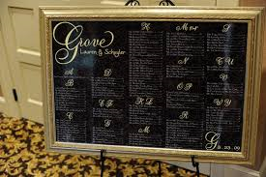
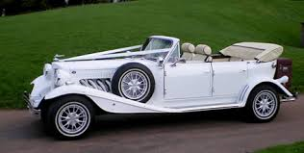

Slide 5
Strategic Thinking
Generating Options
What might happen?
Options
Strategic Decision Making
Making choices
What will we do?
Decisions
Strategic Planning
Taking Action
How will we do it?
Actions
Notes:
The thinking that goes into the plan is the least understood and most ignored part of strategy development.

Slide 6
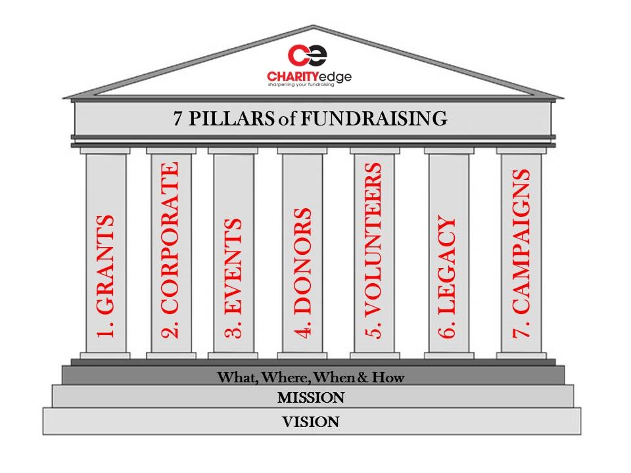
7 Fundraising Pillars

Slide 7
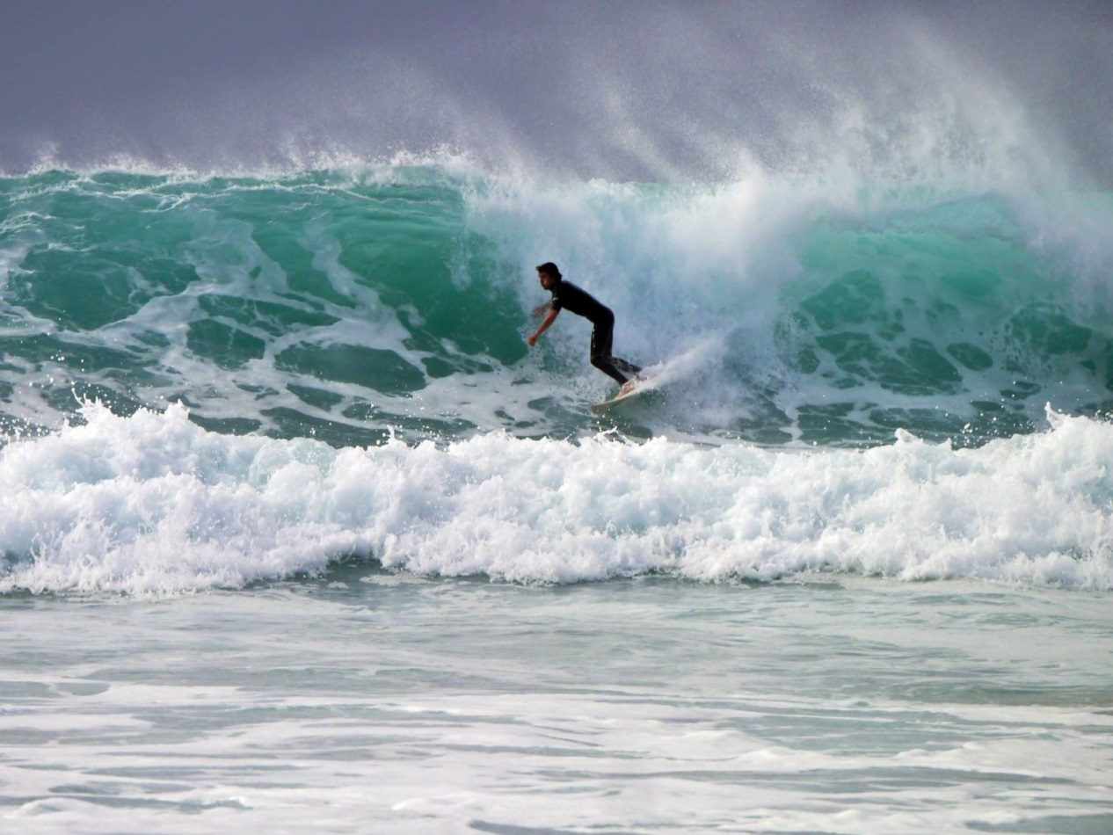
Planning the year/calendar
Position 1
You
Position 2
Leaders
Position 3
Participants
Position 4
Outside
Notes:
Wave Effect
Write down what you think each position means?

Slide 8
Grant Writing
Pre Application:
Finding grants that fit your vision, not just a grant that funds
Application:
Clear, confident and concise
Answer the question (re-read the question several times)
Don’t go over the word count
Only promise what you can deliver
Write to get the funding, not what you think they should hear
Stat’s, surveys, feedback from participants
Post Application:
Strong monitoring and reporting

Slide 9
Corporate Giving

Slide 10
Corporate Giving
Pre Approach:
Why would a company partner with you?
What do you want? // What do they want?
Think through: contract, reputation management, advertising, keeping them happy, renewing the partnership, who do they work with?
Approach:
How do I find the company and right person to speak to?
First contact – telephone, e-mail, in person?
Elevator pitch
What is your need?
Why them?
Sealing the deal
Post Approach:
Your in a relationship, all relationships need work
3 Companies you could approach?

Slide 11
Donor Acquisition
Who:
Individuals, families, children, schools (whose in your world?)
How:
Sponsorship, fundraisers, monthly giving, in-kind, one off gift, events, major donors
Momentum:
Snow ball effect – set realistic targets to start with (family, friends and colleagues)
Notes:
Whose in your world game: write down 3 people that could make a positive impact on your charity (Jamie Oliver illustration)

Slide 12
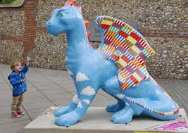
Raising Awareness
Fundraising and marketing campaigns
Social Media – FB, Twitter, Instagram
Media – TV, Newspapers, Magazines, Radio
Have fun as a charity – Break Charity: GoGoDragons
K.I.S.S
Notes:
Create 3 ideas that could raise awareness of your charity this month?

Slide 13
Volunteers
“A leader is someone who knows the way, goes the way, and shows the way” – John Maxwell
Life line of any charity
You can never have enough - RECRUIT
They are free so reward and thank them
(Just Add Spice – time credits)
They represent you – training, values, passion, smile,

Slide 14
Building a Fundraising Strategy

