Slide 1
developing a digital platform
Notes:
Thanks to all

Slide 2
This is how is happened …
Why have we developed it?
First we developed the single point of access
Just One Number
45,000 calls and 5000 answerphone messages were received – over 4000/month, 1000/week and this is increasing weekly
86% calls from Service Users
4800 contacts from young people through ChatHealth, and introduction of Parentline similarly increased access to support
80% calls resolved in a single contact, 20% referred for additional support
Consultation with stakeholders, staff and most importantly service users especially young people – wanted a digital access platform for Norfolk

Slide 3
So what is
A Norfolk focused digital platform to support Norfolk families
Interactive and informative; inspires self-care and behaviour change
A resource which gives parents, children and young people the knowledge, skills and confidence to take care of their health and wellbeing, and seek support when needed
Ease of access to help and support, accessible whenever it’s needed - any time of day or night
Open to everyone and user friendly. Support tailored to the service user’s needs and interests
Opportunity to link with all Norfolk services; helping children, young people and families access the right local information, resources and support to meet their needs
Working in partnership – EAHSN and Baby Buddy

Slide 4
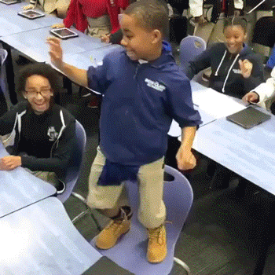
Engagement is being invited to the party
Co-Production is being invited to dance

Slide 5
Guided Tour!

Slide 6
Data
During the Launch of the site we had:
Over 22, 053 page views
Twitter had the equivalent of two months worth of activity
Facebook had 68,000 feeds
Videos had 47,049 views
The team spoke to over 5000 families in Norwich, Gt Yarmouth and Kings Lynn
Over 6000 leaflets were shared

Slide 7
Working Together
Explore the website
Feedback
What do you like about the website?
Any suggestions for improvement?
Any other thoughts?

Slide 8
Promotion
How can we best promote the website to reach Norfolk families?

Slide 9
Phase 2
Continued development of the site and content creation
- Webinars
Online groups
Filming with Norfolk parents
Peer support programme
Wider integration with partner organisations
- Voluntary sector
Norfolk County Council directory
Family Information service
Library Service
Others

Slide 10
Working together
How can you or your organisation work with us to contribute to the development of the website?

