Slide 1
Outcomes Measurement

Slide 2
Why
Demonstrate impact to funders
Demonstrate value to health
Supports planning
Covers a range of outcomes
Comparison with national data
Quality, clinically validated measurement

Slide 3
Why Shared Measurement
Greater partnership working
Demonstrate value of the sector
Encourage single reporting process from funders
Not expensive

Slide 4
Things to consider
Who
Do you have the right demographics – age, gender, cohort
What
Do you have the same measure
Where
Do you have the data to the same geographic level
Notes:
Also consider:
Causality
Variation

Slide 5
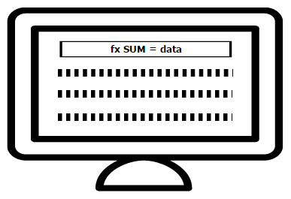
The NCAN framework
Questions when a client come in for advice
Add the answers to the spreadsheet ‘analyser’
Questions 2/3 months after the advice or when the client’s case closes
Add the answers to the spreadsheet ‘analyser’
View results and share with NCAN

Slide 6
What do we ask?
Type of advice
Health
Disability
Housing
Benefits
Children
Employment
Debt
Wellbeing
Follow-up

Slide 7
The Spreadsheet ‘Analyser’
Notes:
This is the questionnaire data page
You should not need to use the questions page – as this makes changes to the boxes that appear here
Blue = Client reference number
Pink/purple = 1st stage questions
Blue/green = stage 2 questions

Slide 8
The Spreadsheet ‘Analyser’
Notes:
This is the results page

Slide 9
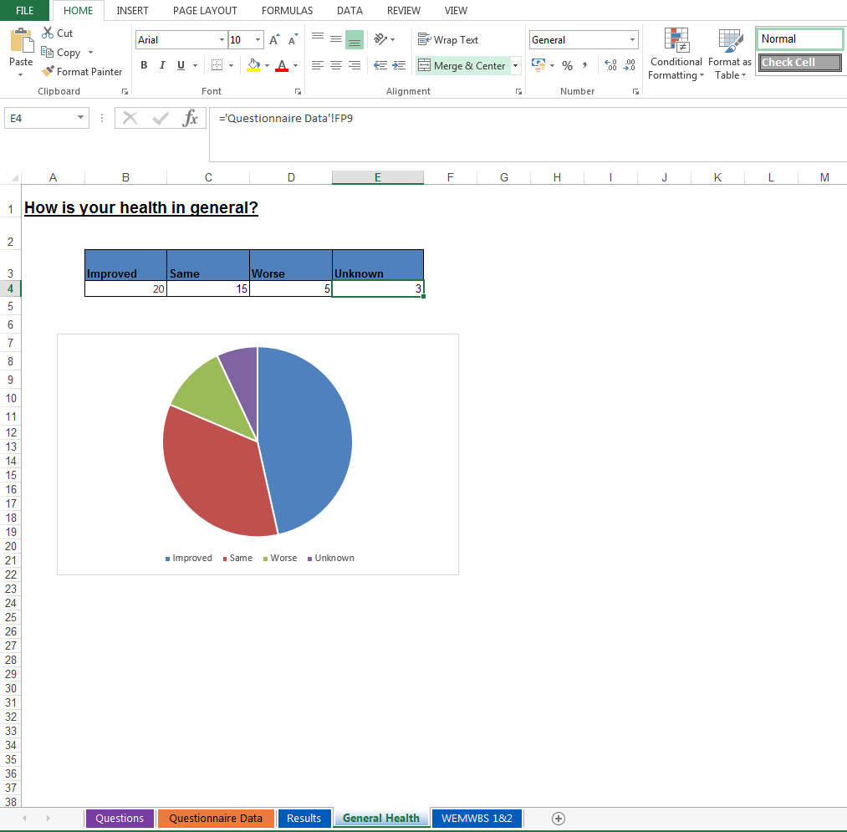
The Spreadsheet ‘Analyser’
Notes:
This is the results page

Slide 10
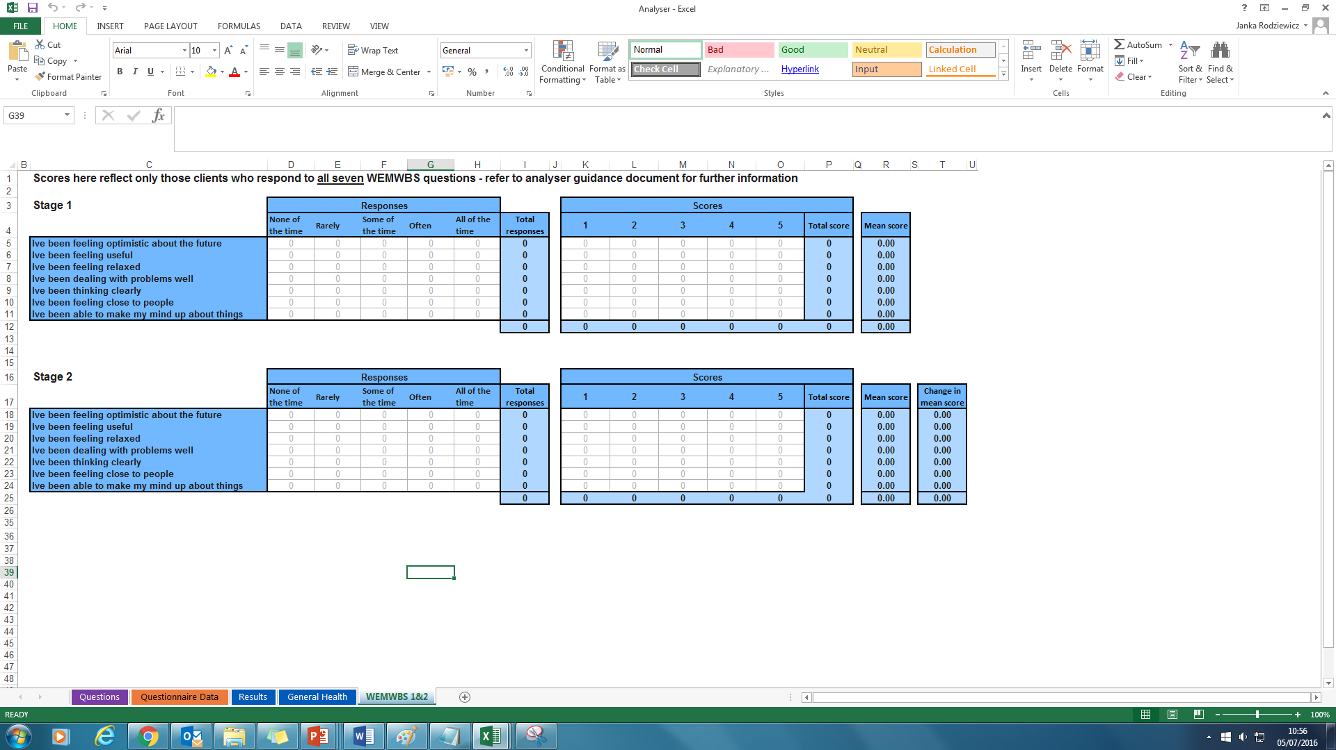
The Spreadsheet ‘Analyser’
Notes:
Shows WEMWBS 1&2 sheet

Slide 11
Reporting
Detailed outcome reports form funders & board
Infographic reporting
Figures for publicity & promotion
Figures for campaigning
Prepared for future evidence needs

Slide 12
Sources of Comparison Data
Norfolk Insight
Joint Strategic Needs Assessment
Office for National Statistics
Public Health Profiles
NHS Digital
Notes:
Norfolk Insight
Demographics – including 2011 Census
Deprivation
Health and Wellbeing
Already collated by area level (LSOA, District, County)
Updated and supported to be the latest published
One source with metadata
Joint Strategic Needs Assessment
Health Profiles
Needs Assessments and Reports
Housing and district authority profiles
Locally written perspectives on many health and wellbeing aspects
Profiles give a set of data and information readily available
Office for National Statistics
Official statistics
Business, industry, Trade and Economy
Employment and labour market
People, population and community
The “official statistics”
Reports and papers relating to the data topics
Public Health Profiles
Public Health Outcomes Frameworks
Children and Young People’s Health Benchmarking Tool
National General Practice and other Profiles
Profiles with national data
Defined Indicators
Maps and Trends
NHS Digital
NHS Outcomes Framework
Health and Health Service Data
Surveys
NHS data in one place
Information and data available by topic

Slide 13
What you can say with the data?

Slide 14
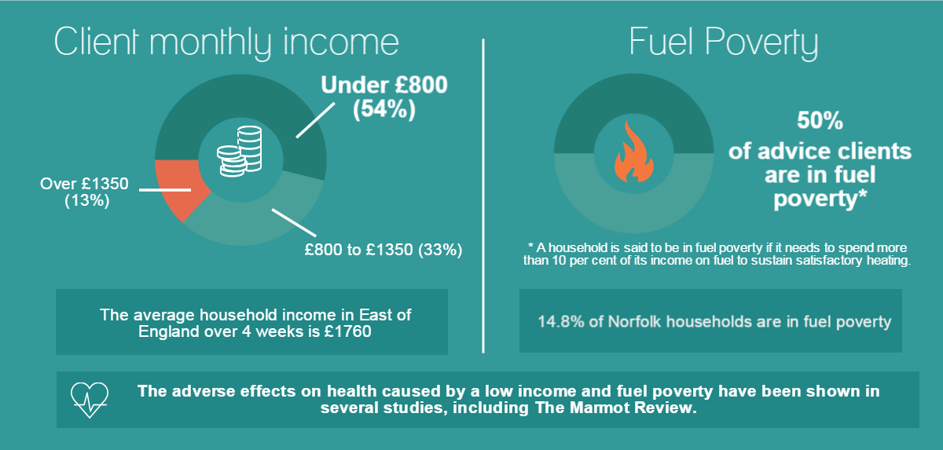
Comparison with national data

Slide 15
Impact
Short
Simple
Appropriate
Effective
Comparable
Powerful
Notes:
Short – up to 10 statements
Simple – all you need to know are your outcomes
Appropriate – only statements which will tell us something, which we can analyse against our outcomes. Statements can be personalised to an extent
Effective – user led evaluation
Comparable – statements may have multiple outcomes; outcomes have multiple statements; (eventually) comparison with local and national real-time data
Powerful – quickly analysed, quick conclusions

Slide 16
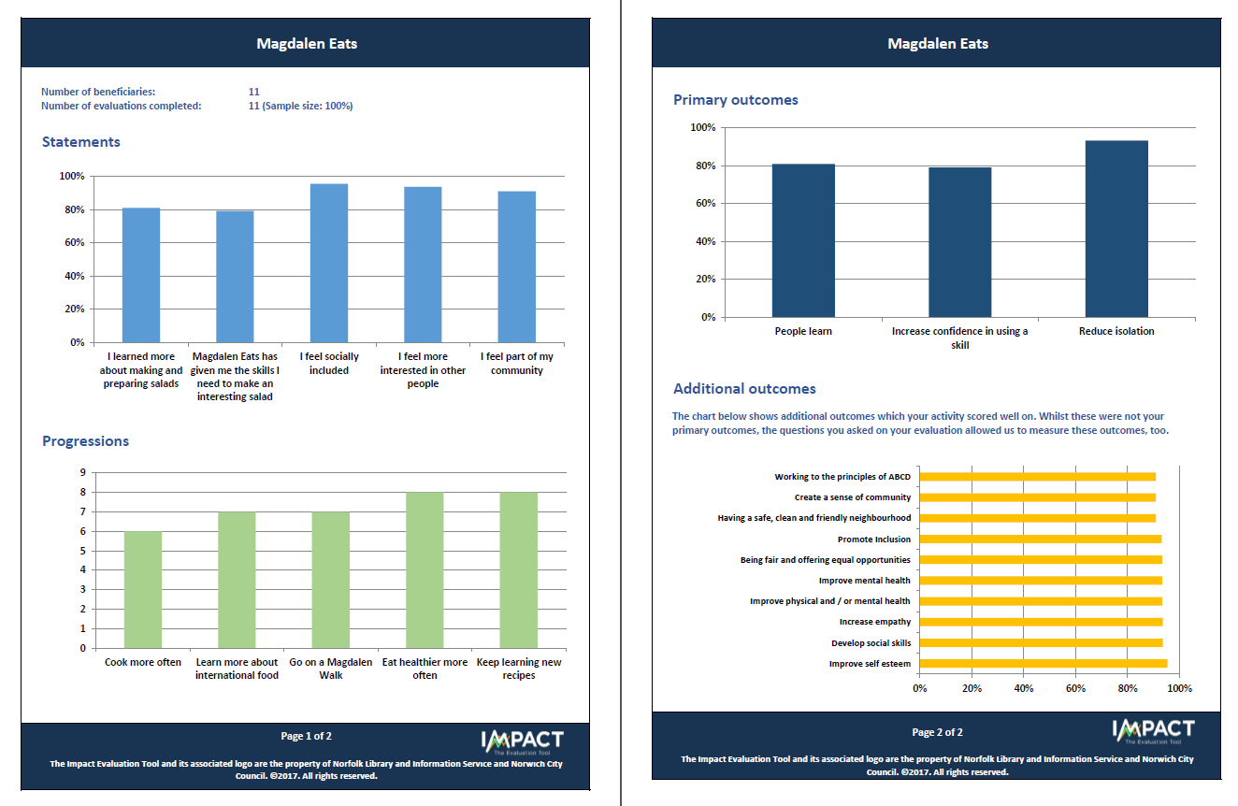
Impact

