Slide 1
Child Criminal Exploitation (CCE)
County Lines

Slide 2
Typical County Line Model
London
Norfolk
SMS/ Phone Calls
SMS/ Phone Calls
SMS/ Phone Calls
Main Contact Controlling the “Line”
“Runners” working for the Line
Local Class A Drug User - Customer

Slide 3
CCE
Child Criminal Exploitation occurs where an individual or group takes advantage of an imbalance of power to coerce, control, manipulate or deceive a child or young person under the age of 18 into any criminal activity
- in exchange for something the victim needs or wants and/or
- for the financial or other advantage of the perpetrator or facilitator and/or
- through violence or the threat of violence.
The victim may have been criminally exploited even if the activity appears consensual. Child Criminal Exploitation does not always involve physical contact; it can also occur through the use of technology.

Slide 4
National Overview
Absence of large amounts of cash.
Young people’s bank accounts being used.
Airbnb use increasing.
Public transport still the major use for trafficking drugs/young people
Nationally it appears that drug demand has not out stripped supply.

Slide 5
CCE team pilot
1. Raising awareness of CCE.
The team deliver CCE briefings across the county to a range of professionals
2. Consultation/advice
The CCE team offer consultations and advice to professionals working with or concerned about a young person potentially involved in CCE. The team can be contacted on 01603 679100 and ask for a member of the CCE team or email CCE-YOT@norfolk.gov.uk.

Slide 6
CCE team pilot
3. Diversion/intervention
The CCE team develop ways of working that serve to protect young people already involved in CCE, violence and crime.
4. Enforcement/disruption
Support the Police to direct strategic work to enforce and disrupt the organized criminals behind the exploitation of young people.

Slide 7
Young people we are working with
14 year old boy - stopped and searched on the street by ‘men’ for ‘plugging’ (carrying drugs inside him)
15 year old boy - pulled out of his house, forced to his knees on the pavement, a gun put to his head
Numerous stabbings unreported, 13 year old helped friend sew up the stab wound
17 year old boy - has been stabbed on more than one occasion
Boys and girls age 12 – 17 – taken overdose and self harmed as they feel no way out
Multiple boys age 14 plus - using sex as control and punishment with girls and boys
14 year old girls paid to assault other girls
Boys and girls taken around the county to hotels – given ‘Xanax and valleys’ so they cannot / do not have to remember what happens!
Girls being threatened to smuggle drugs and phones into prisons inside their body

Slide 8
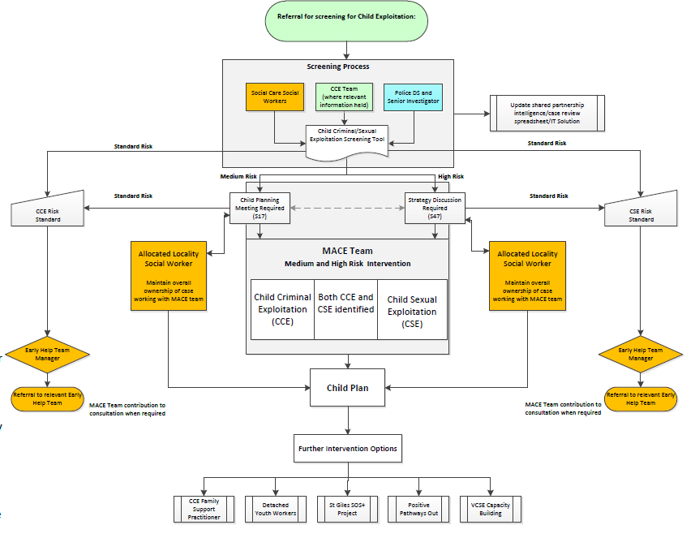
Multi-Agency Child Exploitation Process

Slide 9
Professionals language
Putting themselves at risk- The child may have been groomed
Has been contacting adult males/females via phone or internet- Adult males/females may have been contacting the child.
Drug running – The child is being trafficked for purpose of criminal exploitation.
He/she is choosing this lifestyle- The child is being sexually exploited.
https://www.csepoliceandprevention.org.uk/sites/default/files/Guidance%20App%20Language%20Toolkit.pdf

Slide 10
What you should do if you think a child (or vulnerable adult) is at risk of criminal or sexual exploitation in Norfolk ?
Contact Norfolk’s Children’s Advice and Duty Service (CADS) on 0344 800 8021.
Alternatively ring Norfolk Police by telephoning 101. In an emergency always dial 999.

